Slide 1
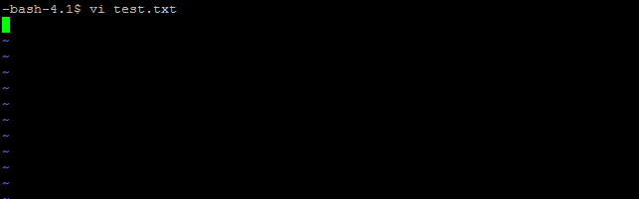
Vi editor
The vi editor (short for visual editor) is a screen editor which is available on almost all Unix systems.
To start using vi, at the Unix prompt type vi followed by a file name. If you wish to edit an existing file, type in its name; if you are creating a new file, type in the name you wish to give to the new file.
Eg: vi test.txt
You will notice a tilde (~) on each line following the cursor. A tilde represents an unused line. If a line does not begin with a tilde and appears to be blank, there is a space, tab, newline, or some other non viewable character present.

Slide 2
Vi Modes
Command mode − This mode enables you to perform administrative tasks such as saving files, executing commands, moving the cursor, cutting (yanking) and pasting lines or words, and finding and replacing. In this mode, whatever you type is interpreted as a command
Insert mode − This mode enables you to insert text into the file. Everything that's typed in this mode is interpreted as input and finally it is put in the file
vi always starts in command mode. To enter text, you must be in insert mode. To come in insert mode you simply type i. To get out of insert mode, press the Esc key, which will put you back into command mode.
Cursor Movement
You must be in command mode if you wish to move the cursor to another position in your file. If you've just finished typing text, you're still in insert mode and will need to press ESC to return to the command mode.
Moving One Character at a Time:
h left one space l right one space
j down one space k up one space

Slide 3
Deleting Characters
Command | Description
x | Deletes the character under the cursor location.
X | Deletes the character before the cursor location.
dw | Deletes from the current cursor location to the next word.
d^ | Deletes from current cursor position to the beginning of the line.
d$ | Deletes from current cursor position to the end of the line.
D | Deletes from the cursor position to the end of the current line.
dd | Deletes the line the cursor is on.

Slide 4
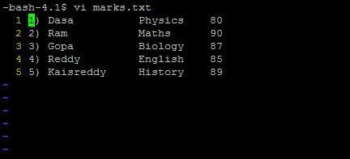
Set Command to display line numbers
:set nu Displays lines with line numbers on the left side.

Slide 5
Quitting and Saving a File
:w to save your file but not quit vi (this is good to do periodically in
case of machine crash!).
:q to quit if you haven't made any edits.
:wq to quit and save edits (basically the same as ZZ).
Quitting without Saving Edits
:e! reads the original file back in so that you can start over.
:q! wipes out all edits and allows you to exit from vi.
IMPORTANT
Here are the key points to your success with vi −
You must be in command mode to use commands. (Press Esc twice at any time to ensure that you are in command mode.)
You must be in insert mode to enter text.

